Slide 1


Slide 2
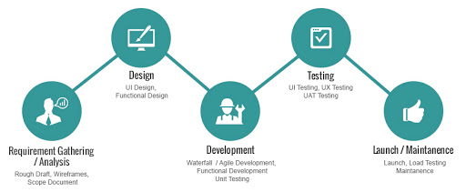
Process in UI Development
Requirement Gathering and Analysis
Rough Draft
Wireframe
Design
UI Design
Functional Design
Development
Code and Functionality
Unit Testing
Testing
UI & UX testing (Manual or Automation Testing)
Launch and Maintenance
Bug fixing or New Adding Feature

Slide 3
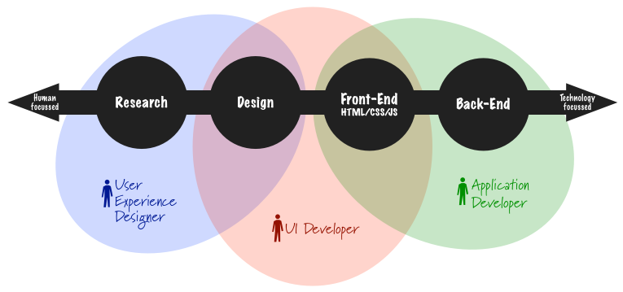
Roles of Developer

Slide 4
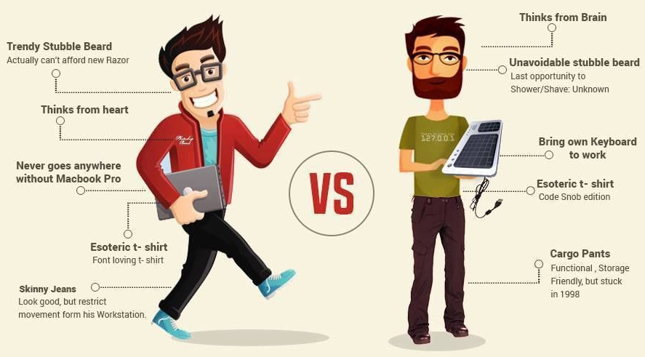
UX (Web Designer) vs UI (Web Developer)

Slide 5
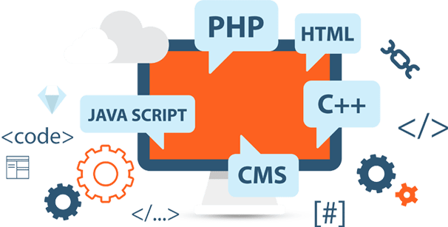
Web or Front End - Development

Slide 6
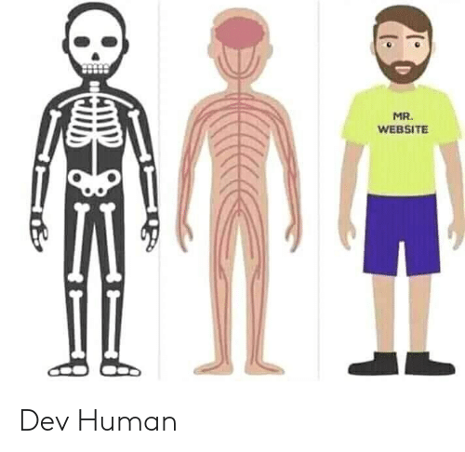
Three Layers of Web
Structure Layer
The Skeleton
Behaviour or Functional Layer
The Nerve and Brain
Style or Presentational Layer
The Look and Appearance

Slide 7
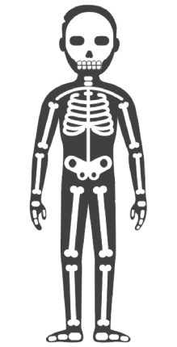
HTML - The Skeleton
HTML - Hyper Text Markup Language
HTML provides tags (name) to describe types of content on your website
Example: <header>, <footer>, <body>
Responsible for translation of the UX design (wireframes) to actual code that will produce visual elements of the application in web browser.
File extension - filename.html

Slide 8
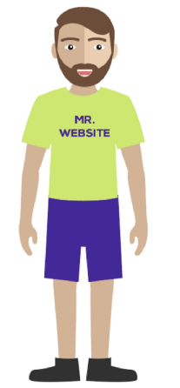
CSS - The Skin
CSS - Cascading Style Sheet
CSS will make our site presentable and enhance the user experience for web site
CSS allow you to add color, modify sizes, embed background images and make your design responsive for desktop and mobile.
File extension - filename.css

Slide 9
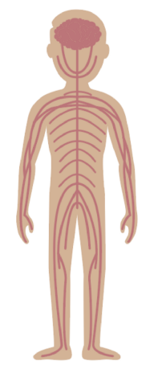
JS - The Brain
JS - JavaScript
Javascript is a dynamic type and high level programming language
Javascript is not equal to Java
JS will provide the brain and muscles of the website allowing it to interact the web page
File extension - filename.js

Slide 10
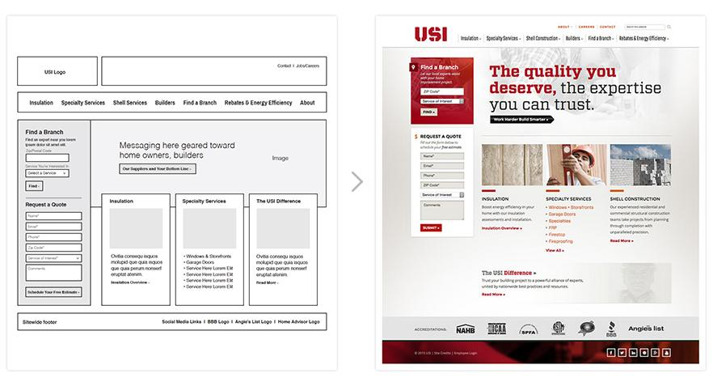
Wireframe to Web Page

Slide 11


